Slide 1

8. Spectral Calibration
Dr. David R. Thompson
Jet Propulsion Laboratory, Imaging Spectroscopy Group

Slide 2
Goals for this module
Resample spectra using spectral response functions
Recognize and correct spectral calibration errors

Slide 3
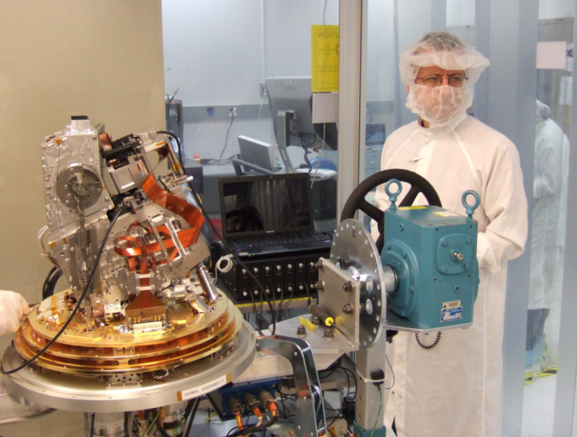
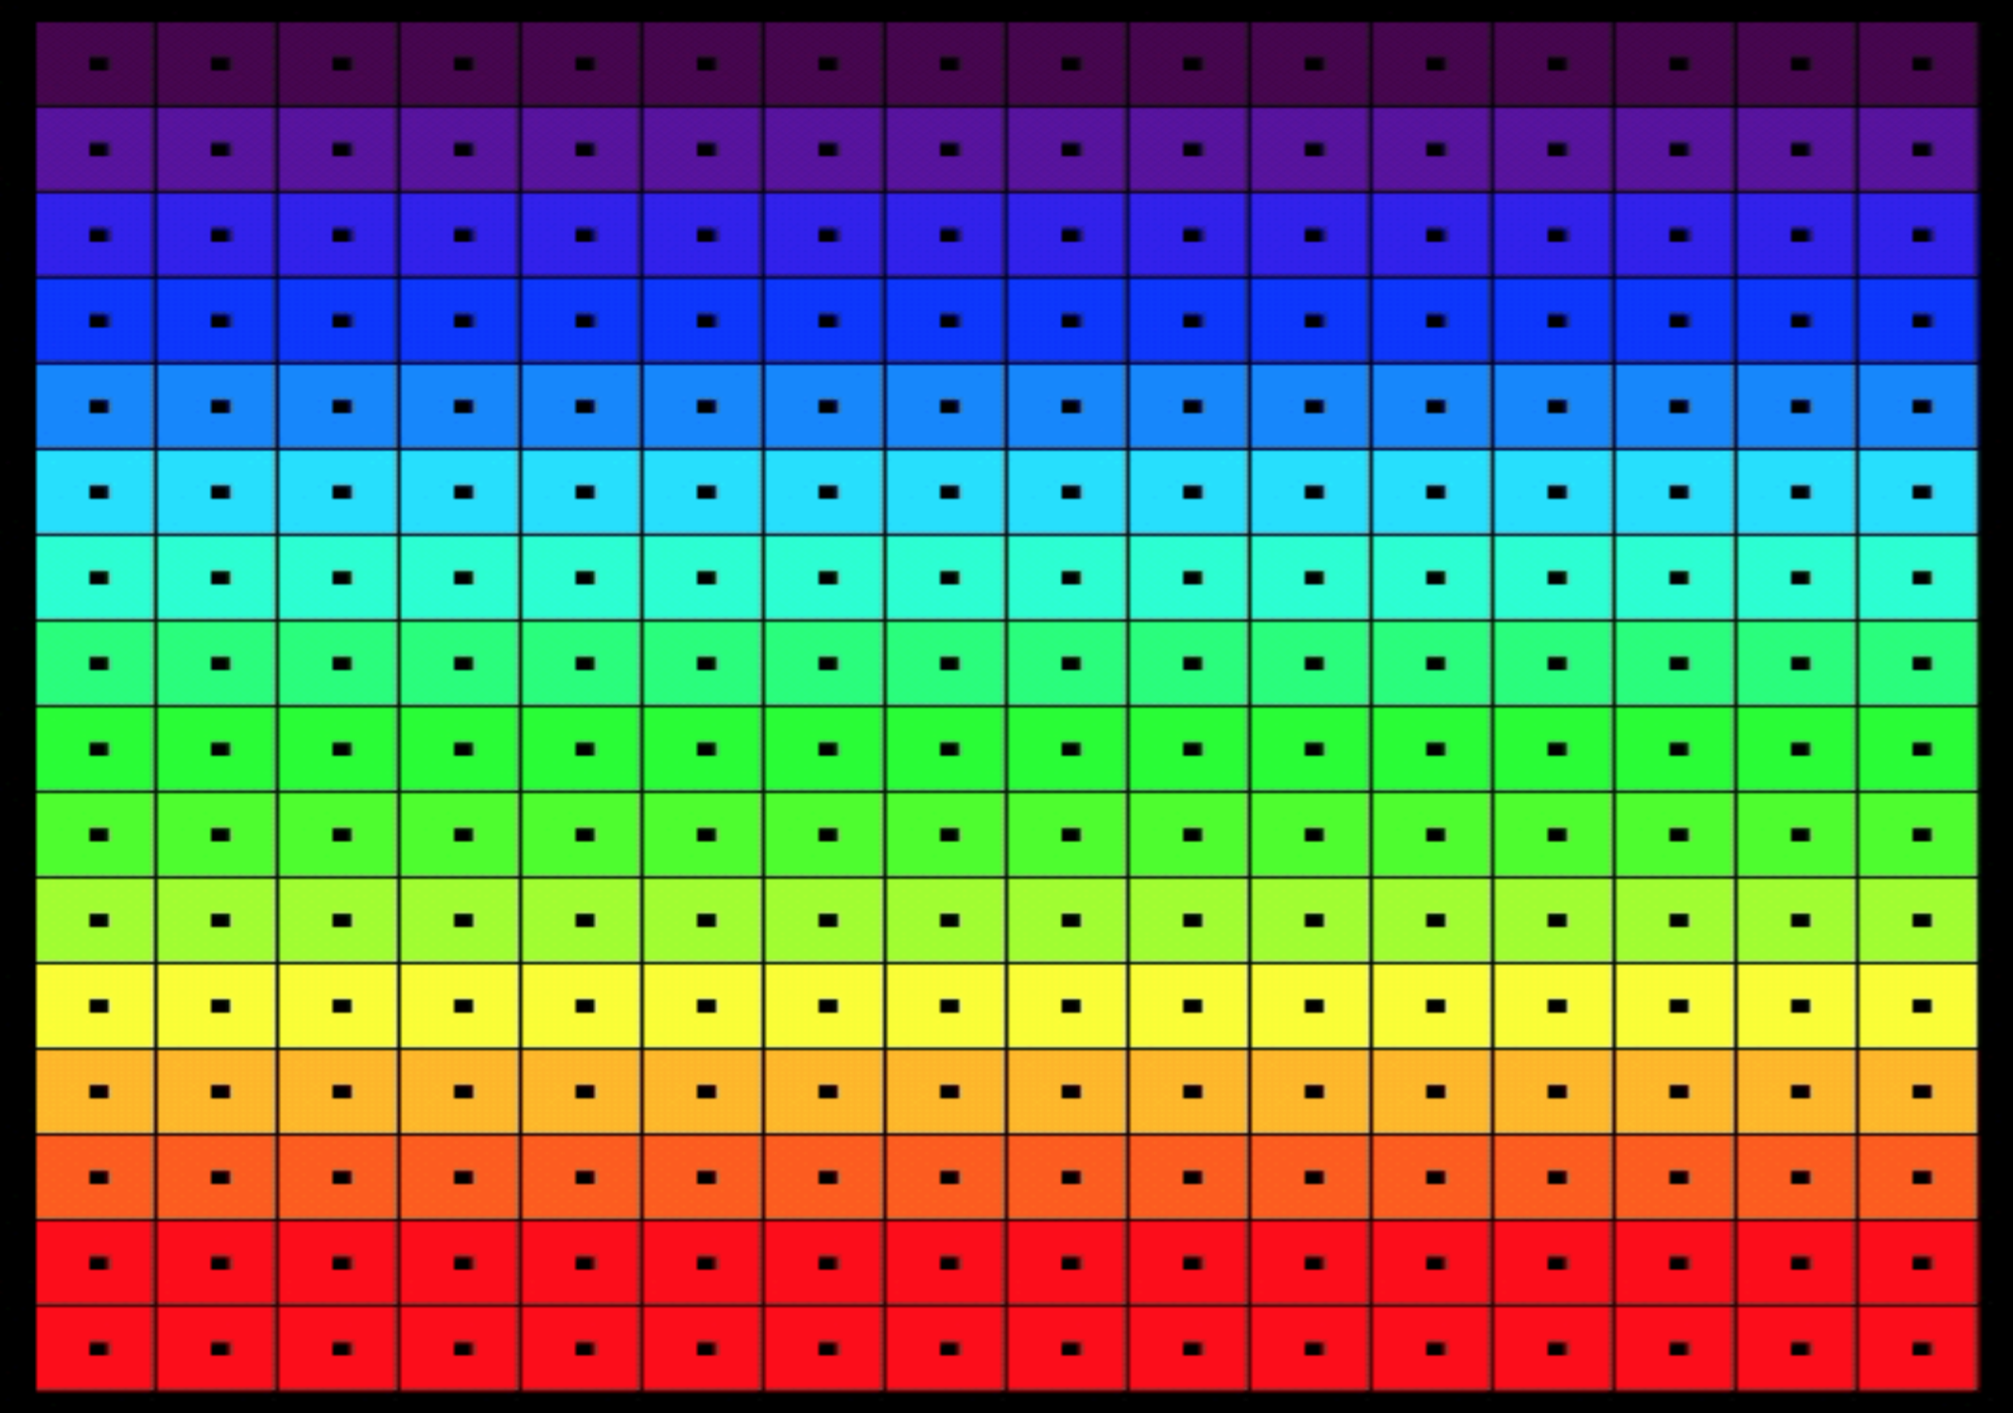
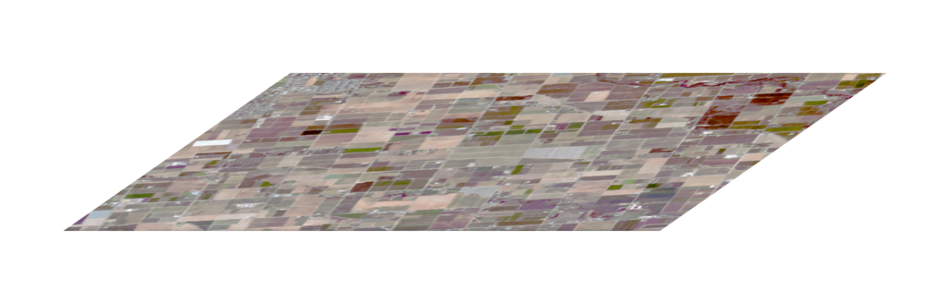
Conventions
Recall our idealized Focal Plane Array (FPA).
Spectral Calibration is the process of determining the wavelengths to which each FPA row responds.
Each detector element is sensitive to a range of wavelengths.
FPA
Spectrometer
Slit
Telescope
Rows (spectral channels)
Samples (cross-track locations)

Slide 4
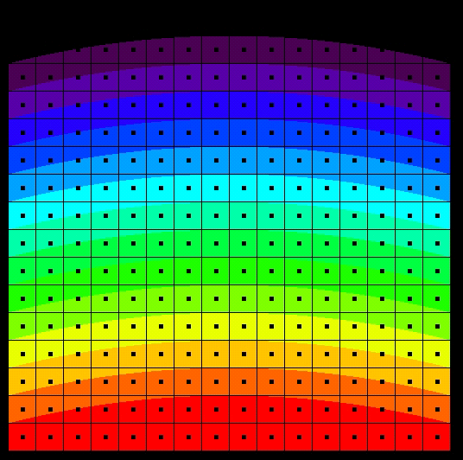
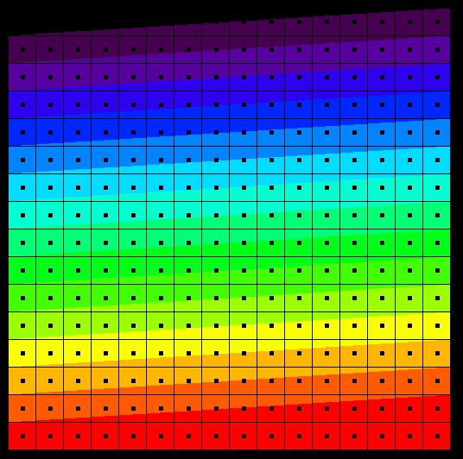
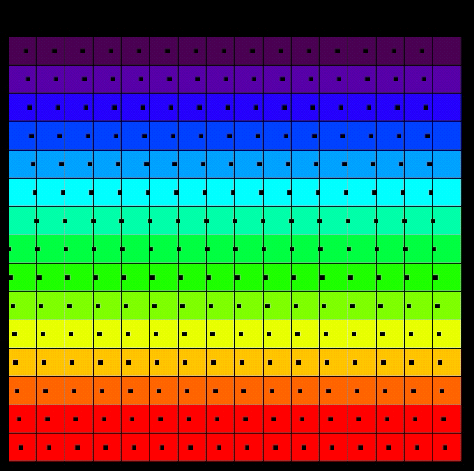
Flavors of non-uniformity
Cross Track Sample
Wavelength
Physical detectors often exhibit different kinds of alignment-related nonuniformities.
These distortions should also be characterized during the spectral calibration process.
Requirement
Failure by Frown
Wavelength
courtesy
Robert O. Green, JPL
Failure by Twist
Failure by Spectral-IFOV-Shift

Slide 5
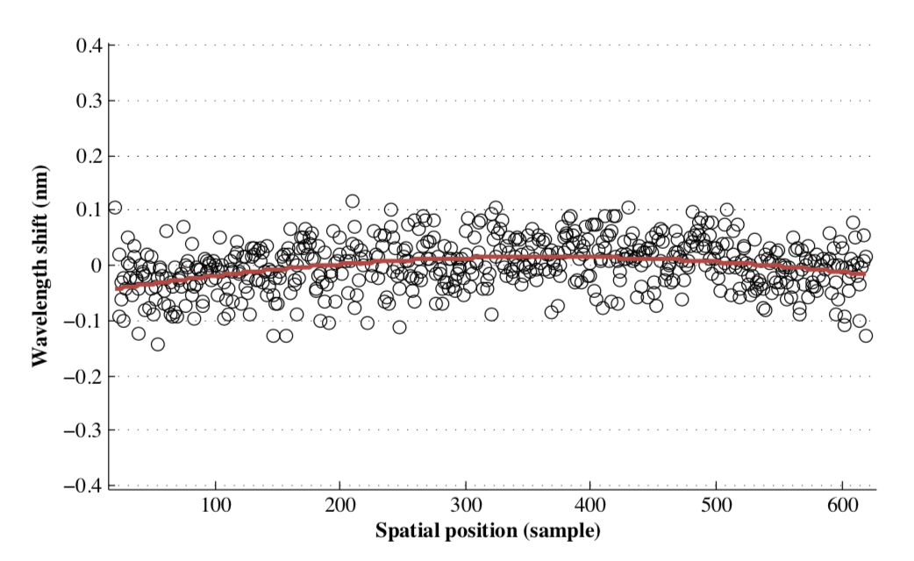
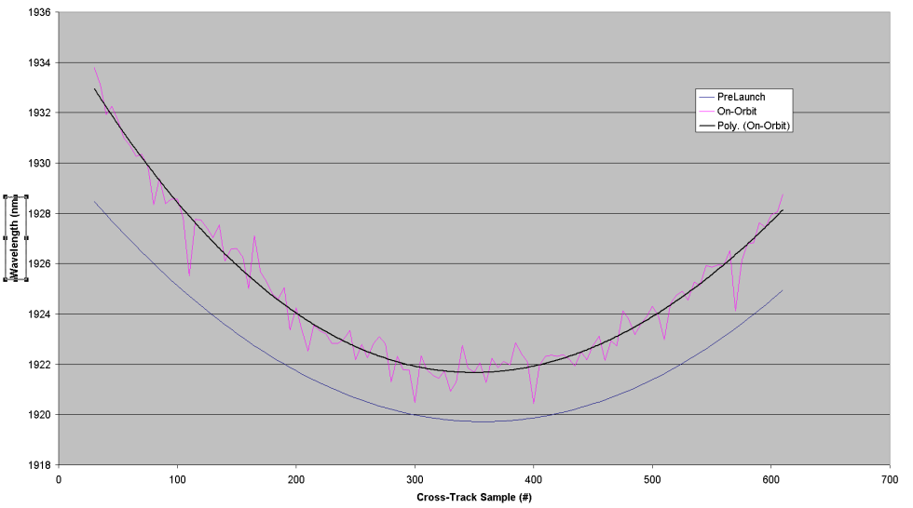
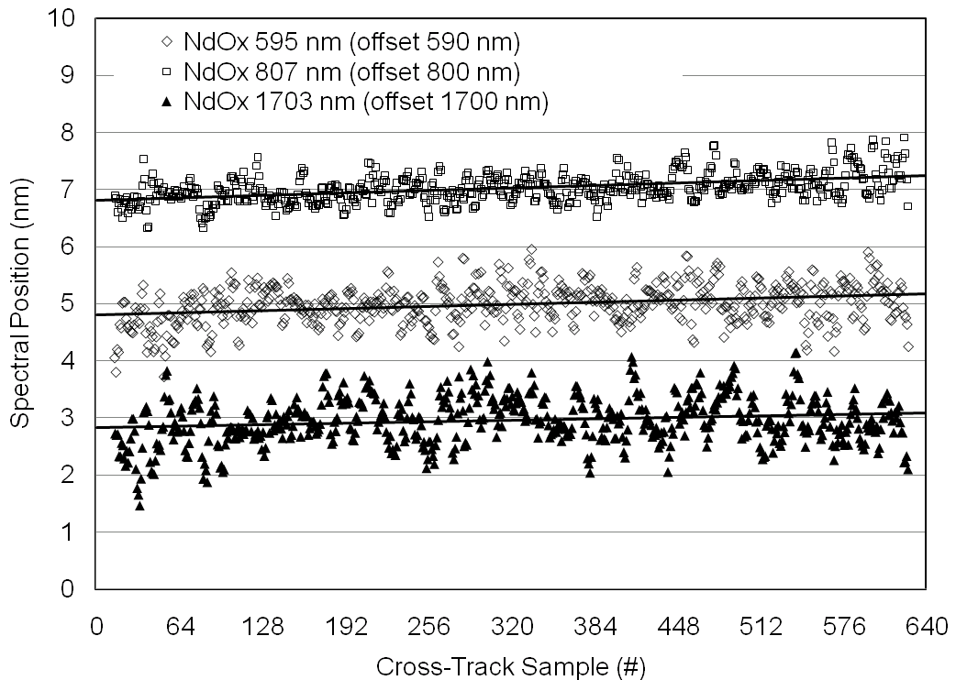
Uniformity achieved
(courtesy Robert O. Green, JPL, and others)
AVIRIS-NG
[Thompson et al., AMT 2015]
CRISM 2005
JPL M3 2008
Hyperion 2000

Slide 6
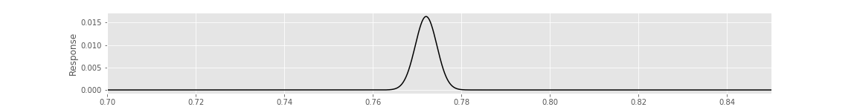
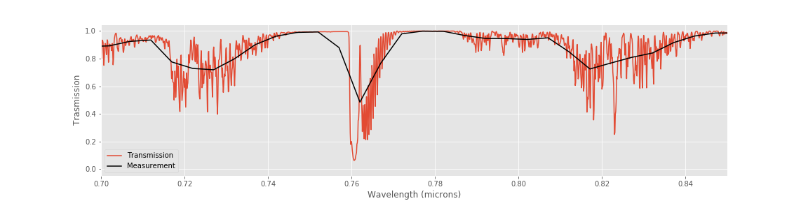
Spectral response functions
Typically we assume detector elements have Gaussian responses with known Full Widths at Half Maximum (2.355 standard deviations).
To simulate a channel’s measurement of a high-resolution feature, we sum all wavelengths, weighting by the relative response of the channel. Make sure the response function itself integrates to unity!

Slide 7
Wavelength fitting
Often the best spectral calibration standard is the atmosphere itself. By fitting the measurement (green) to the known features of the atmosphere (red) we find the best-matching wavelength spacing and offset.
Courtesy Robert O. Green

Slide 8
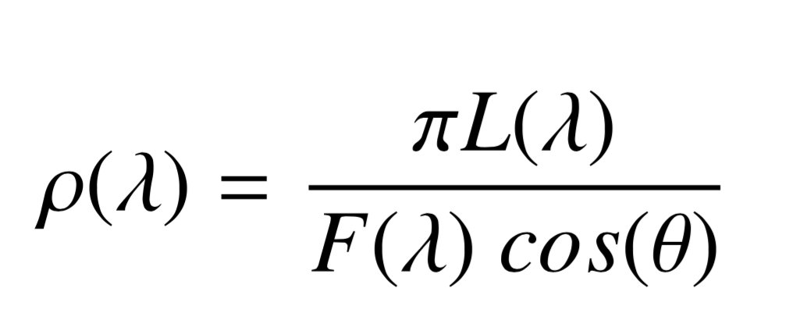
Wavelength fitting with the atmosphere
1. Calculate an average Top of Atmosphere (TOA) reflectance for each cross-track position. This normalizes for the variable solar illumination, expressing the measurement as a fraction of incoming irradiance.
Measured radiance
Solar irradiance
Solar zenith
Typical TOA reflectance values are greater than zero, and less than one.

Slide 9
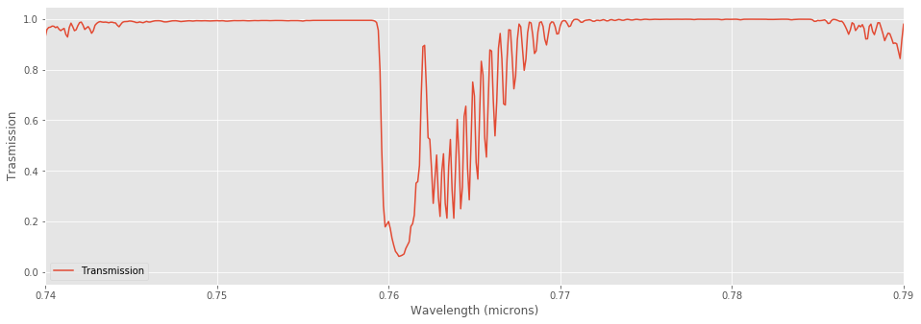
Wavelength fitting (contd.)
2. Get a transmission spectrum for an obvious, sharp atmospheric feature using an appropriate Radiative Transfer Model (I often use 6s or MODTRAN).

Slide 10
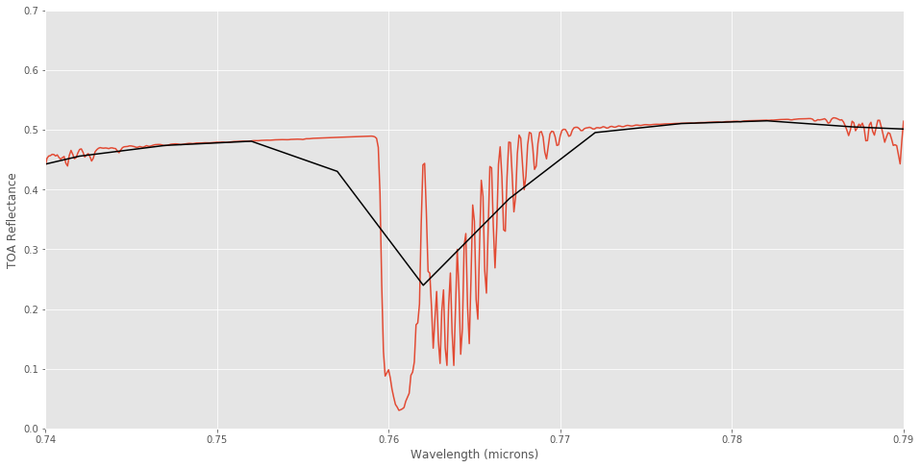
Wavelength fitting (contd.)
We model the observation as a linear “continuum” multiplied by the transmittance and then sampled by the instrument
Continuum
Measurement
Continuum x Transmittance

Slide 11
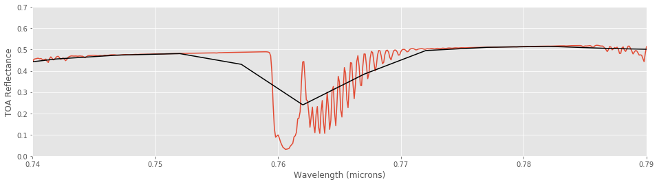
Wavelength fitting (contd.)
3. Use a nonlinear optimization routine to fit continuum and absorption depth. We find the model which best fits the measured feature (note – this only works over short wavelength intervals
Spectral response
Absorption shift, depth
Position of linear continuum

Slide 12
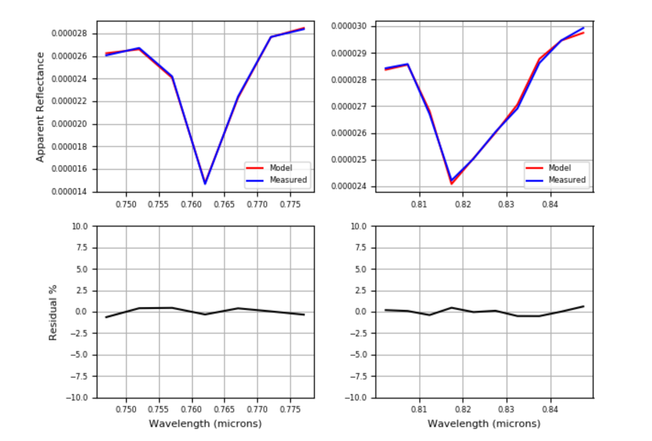
Wavelength fitting example
Apparent reflectance
Apparent reflectance
[Thompson et al., Atmos. Meas. Techniques 2015]
Residual error
Residual error
Common features used for this purpose include the oxygen A band (760 nm) and Near-Infrared H₂O vapor absorptions

Slide 14
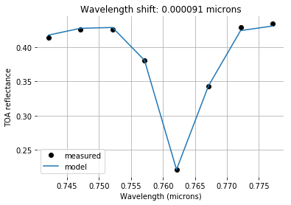
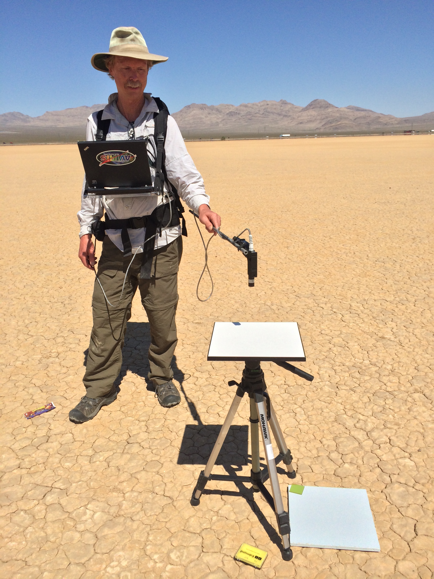
Exercise 8: Spectral Calibration
Objective: Use the atmosphere as a calibration object. Fit a modeled transmission spectrum to TOA observations.
Files include two examples of TOA reflectances acquired by the AVIRIS-NG instrument onboard a b-200 aircraft over Ivanplah playa. The exercise notebook contains fitting routines, and a transmission spectrum for appropriate observing geometry and water vapor loadings.
Pick an atmospheric feature, and eyeball an initial calibration. Start with a spectral response function that is 5-6 nm Full Width at Half Maximum. Then, fit wavelength shifts to fine tune your initial guess. Is there a way of quantifying how accurate this method can be?

